Slide 1

How to Improve Our Company’s Attrition Rate
Through data analysis of our employee records
Afreen Siddiqui
Bruce Kimbark

Slide 2
Overall Turnover Rate
Our Attrition Rate last year was 16.1%.
Of our total employee count of 1,470, we had 237 leave the firm.
This is an extraordinarily high number which leads to costs in both production, new hire training, and employee morale. We need to do better.
By analyzing the data we have collected on all our employees, our hope was to find trends and a way to identify those employees likely to leave. We believe we have done that.
With this information in our possession, we can start to make changes here that will help employee retention and improve Uno Solutions moving forward.

Slide 3
Job Related Indicators
Salary, Overtime, Role, Specialty

Slide 4
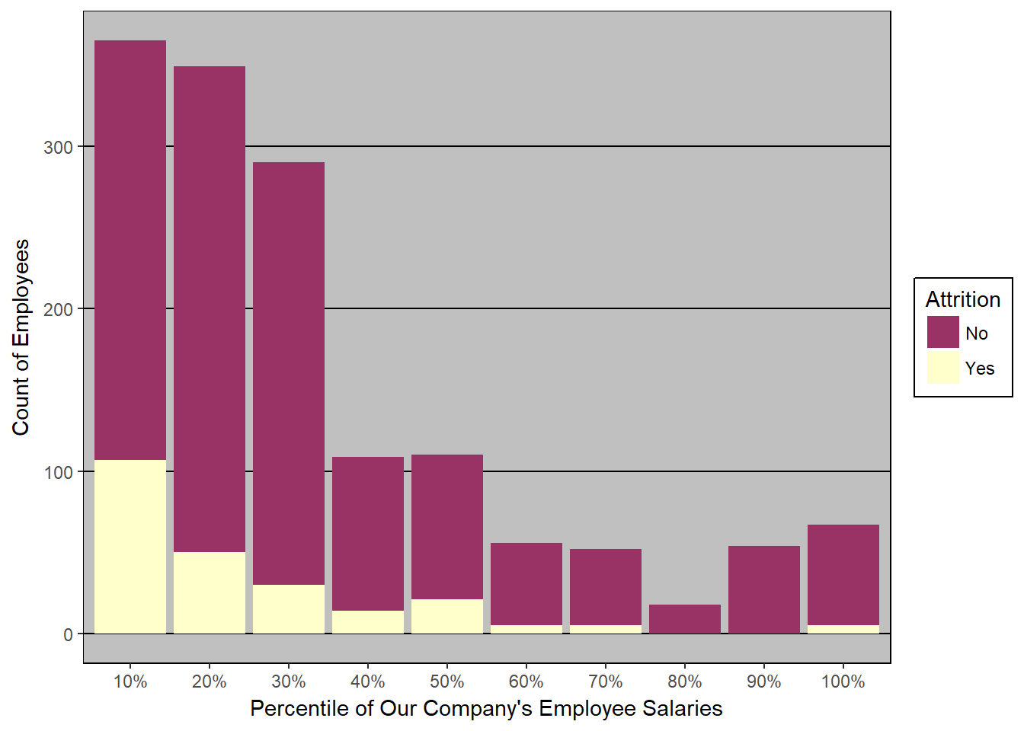
Monthly Income
The attrition in absolute terms decreases as the salary increases, thus lower salary is contributing towards attrition.
This shows negative correlation between salary and attrition. The less we pay our employees the more likely they are to leave.

Slide 5
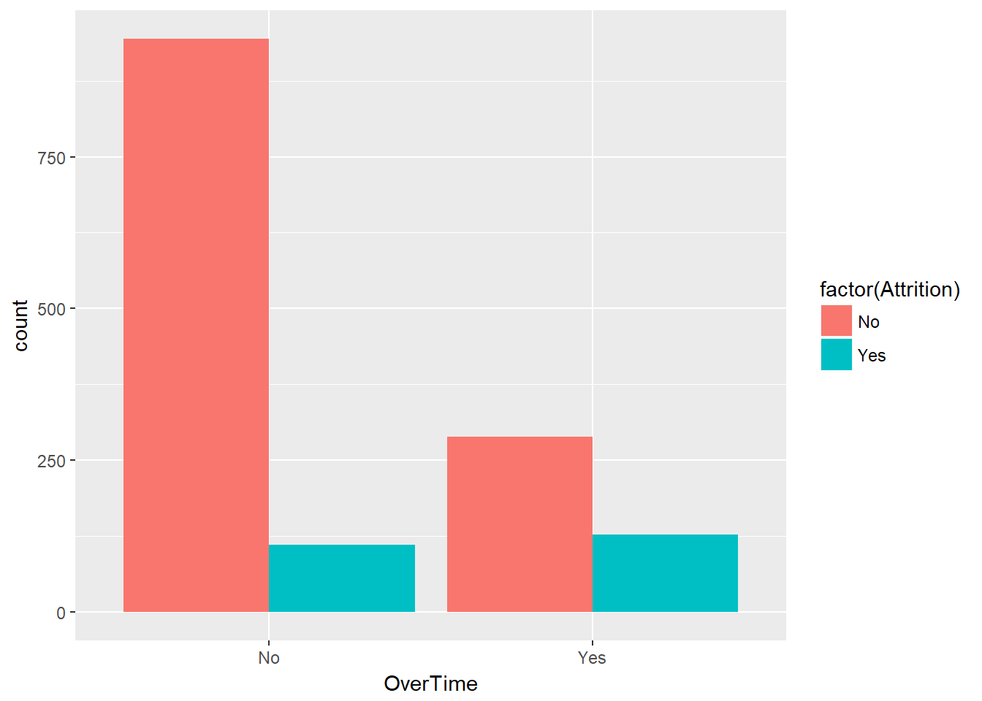
Unhappiness Regarding Overtime
As the chart to the right shows, those employees who work overtime are much more likely to leave.

Slide 6
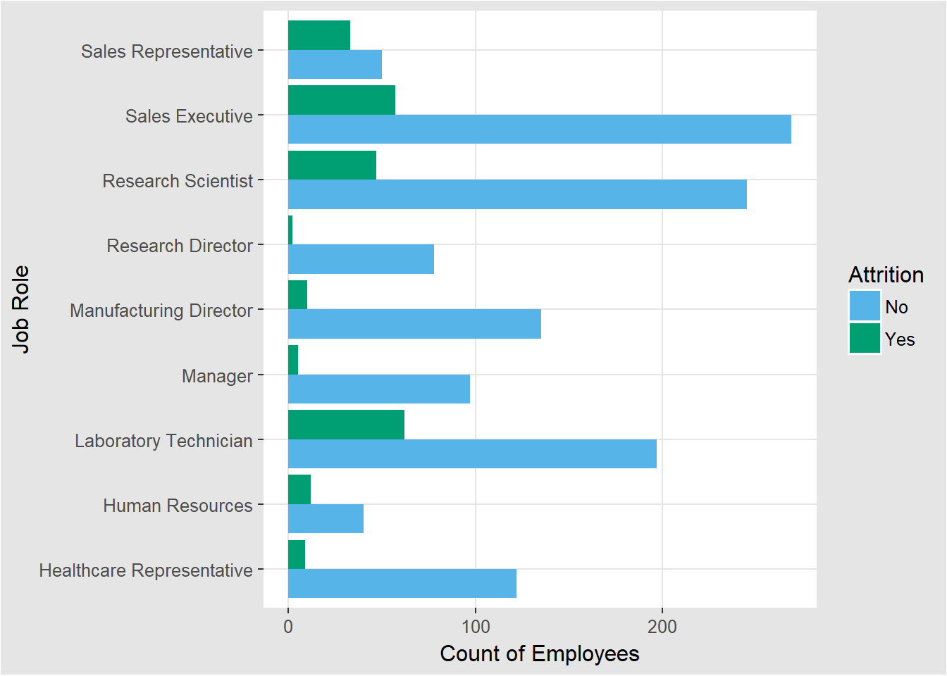
Job Role
Laboratory Technicians followed by the Sales Executives are contributing the maximum towards attrition.
In percentage terms, Sales Representative are far ahead at 66%.

Slide 7
Income vs Department
Sales department has the highest Average Income.
The employee who left the company has the lesser than average salary for their respective department.
Employees with higher salaries are with the company

Slide 8
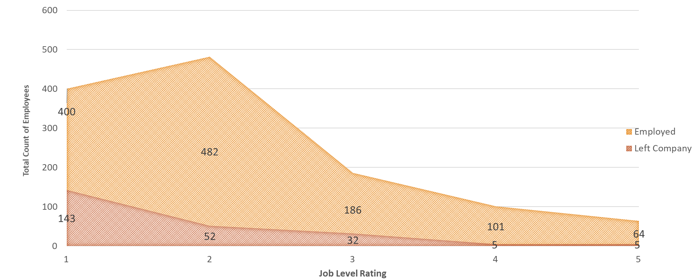
Who Left or Stayed vs Job Level Rating
Those with entry level jobs and lower titles leave at a very high rate.
Whereas those who we have in leadership and management positions have stayed with the company.
We should promote those who are the best employees as quickly as possible for the best chance to hold onto them.

Slide 9
Personal Factors
Age, Years worked, marital status

Slide 10
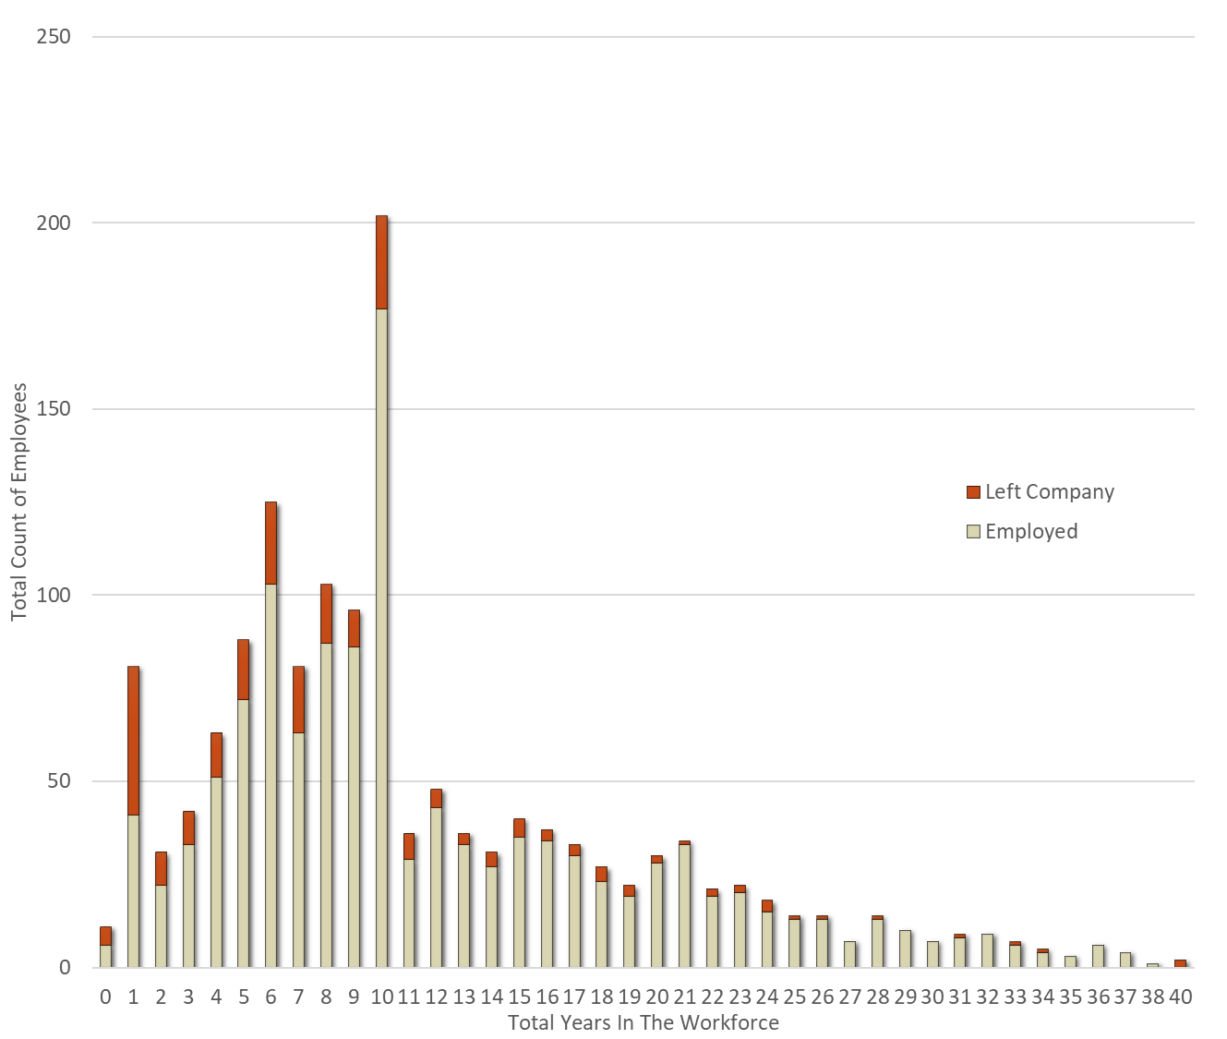
Employees Total Working Years and When They Left
An overall view of our employee base.
Our attrition rates are around 50% for employees under 2 years experience but this is expected.
The attrition rate is also expectedly low for those later in their careers.
We are concerned with those between 2 and 11 years of experience.

Slide 11
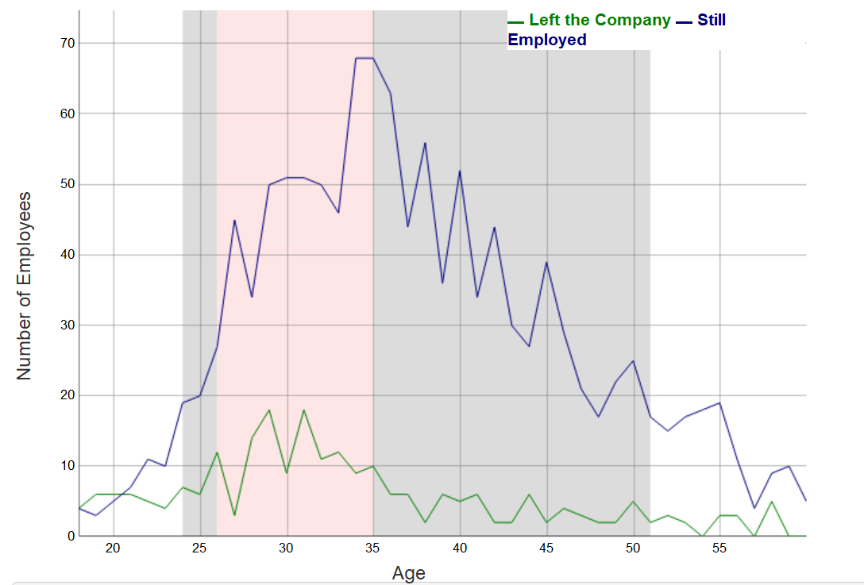
Attrition by Age
Attrition spikes between the ages of 26 and 35.
The 26 to 35 age group represents 41.22% of our total employee base.
86.73% of our employees are between the ages of 24 and 51.
We want to hold onto as many of these employees as possible especially since these are their most productive years in the workforce.

Slide 12
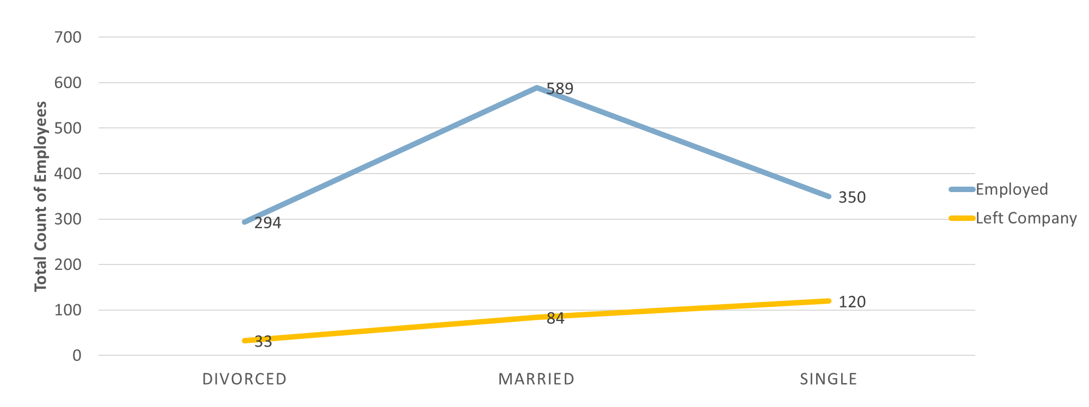
Turnover by Marital Status
Those Divorced and Married have very low attrition rates but those Single have incredibly high turnover.
This is obviously out of our control but a data point we can use to identify chance of leaving.

Slide 13
Variables that Do Not Have an Impact that would be expected to
Education, Hourly rate, Survey Responses

Slide 14
College Educational Background
Most of our employees have schooling in Life Sciences and Medical followed by Marketing.

Slide 15
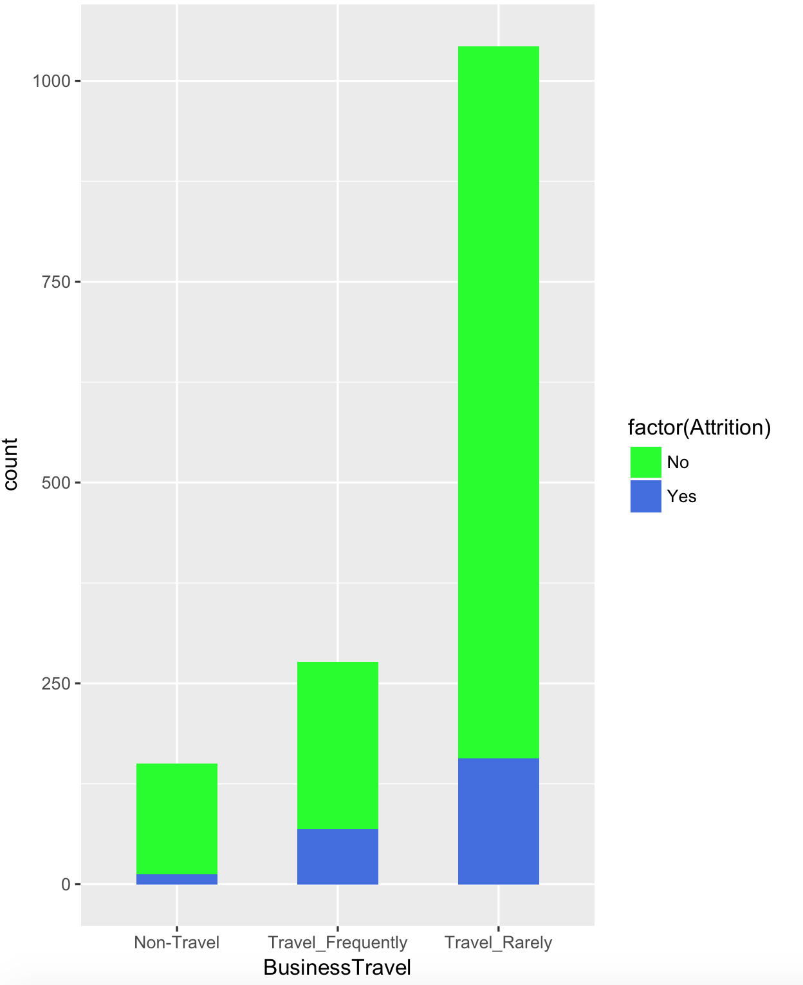
Hourly Rate and Business Travel
Attrition Based on Hourly rate
Business Travel frequency

Slide 16
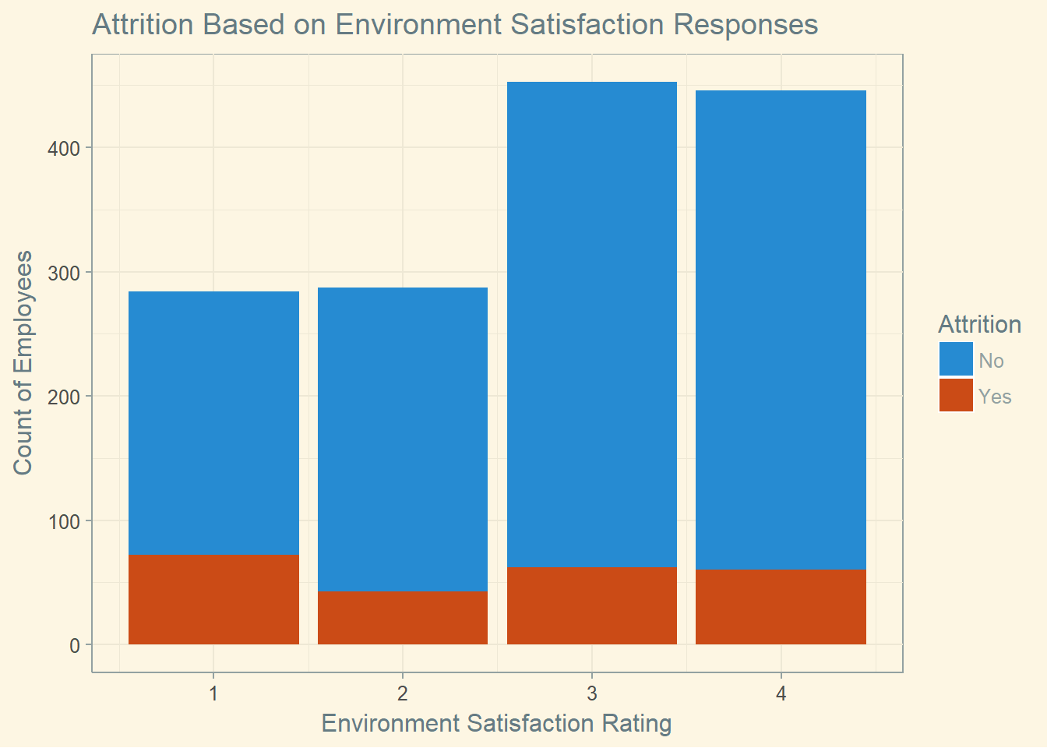
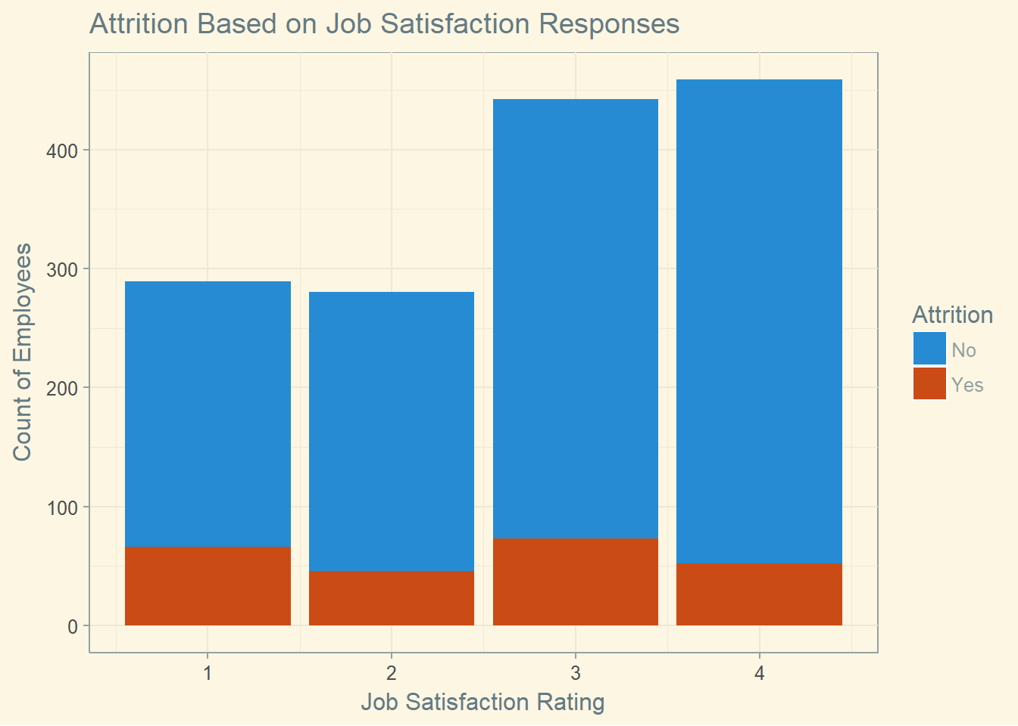
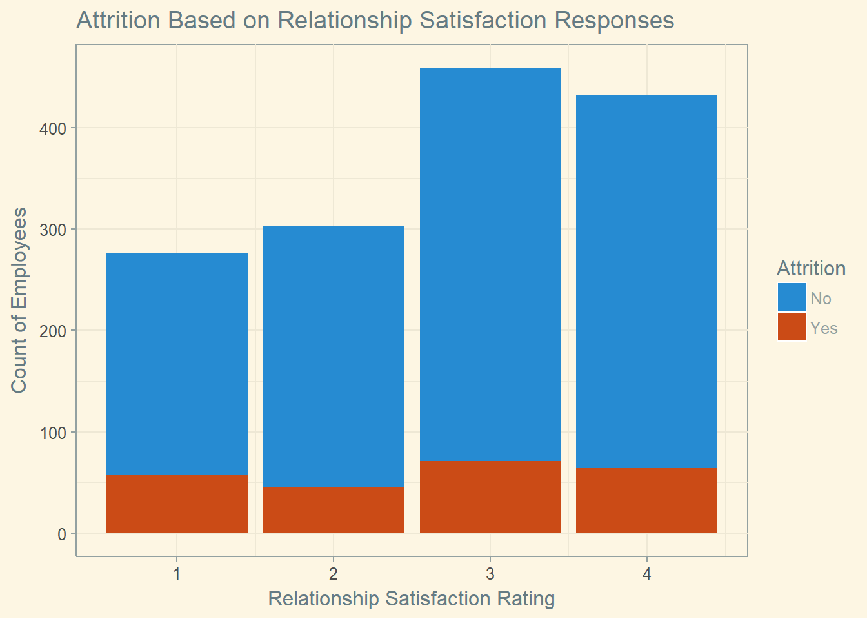
Our Employee Satisfaction Survey
The below charts show that the responses taken by themselves have no impact or quantifiable trend on attrition rates.

Slide 17
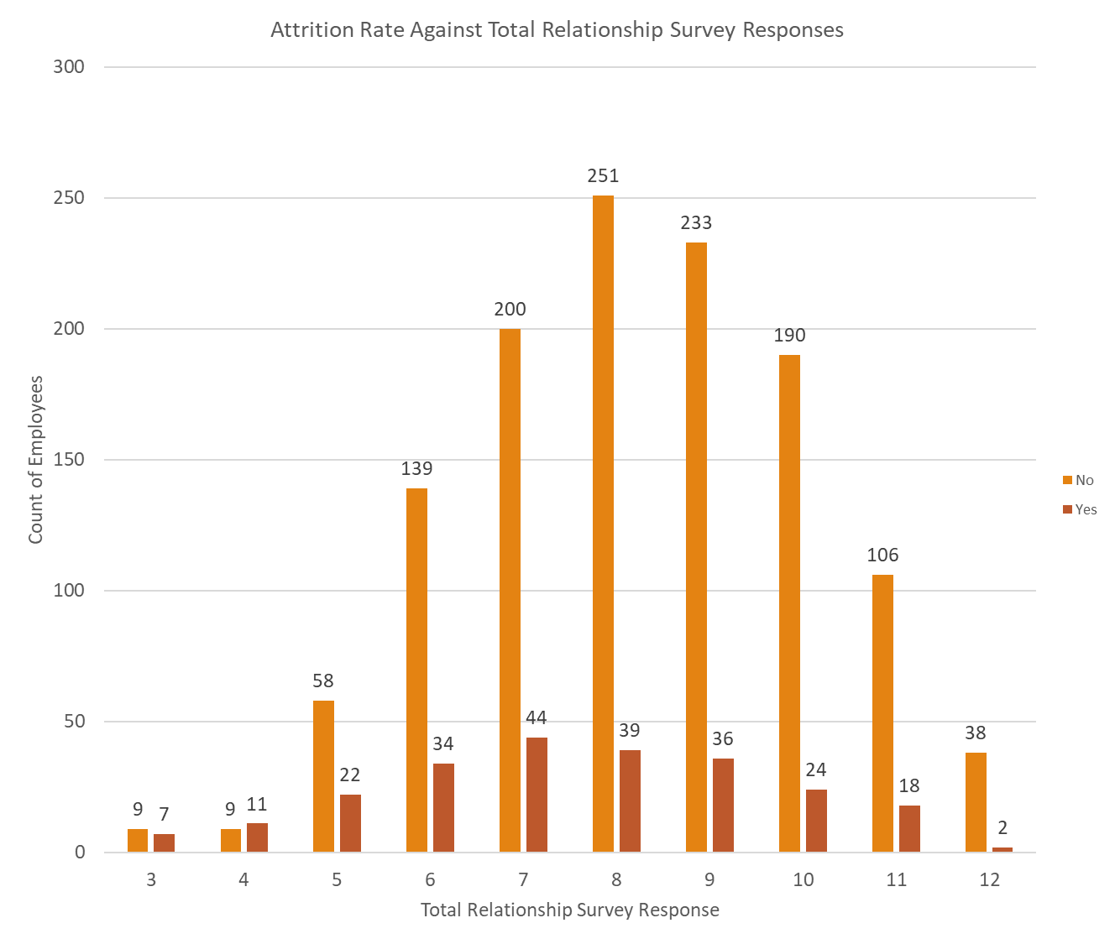
Survey Subtotals Improves Data But Only Slightly
By taking the subtotal of the 3 surveys – Minimum Possible Score is 3 and Maximum Possible Score is 12 – provides a different view
It shows that attrition rates are much higher at the lower ranges but attrition only decreases slightly across the spectrum

Slide 18
Analysis Using All Varying Data Points
Can trends be discovered by quantifying as much of the data as possible?

Slide 19
Our Data Has 34 Total Variables
Data We Used
27 Totals Variables
The Job Related Factors
The Personal Factors plus Gender
The Satisfaction Survey plus other responses such as Job Involvement, Work Life Balance, Distance From Home
Number of Companies Worked, Years At our Company, Years In Current Role, Years Since Last Promotion, Years With Current Manager
Data Omitted
Employee Number, Employee Count
Daily Rate, Hourly Rate, Monthly Rate
Standard Hours
Over 18

Slide 20
Our Method
We took each variable and determined the percentage attrition rate by response
For example, there are three responses to the Business Travel variable: Frequently, Rarely, and Non Travel
The Attrition Rate for each is
Frequently: 24.91%
Rarely: 14.96%
Non Travel: 8.00%
So all employees who travel Frequently receive a Travel Attrition Score of .2491.
This was repeated across the 27 variables.
The values were then subtotaled for each employee into a Total Attrition Score.
Benefits
We are able to use all of the data available
We do not give excessive importance to any of the variables
We use direct attrition percentage from the data so the data tells us what is important
As data is added, it will be more accurate and can begin to predict who is at risk to leave
Flaws
Confounding Variables – Several data points could be directly correlated.
Could indirectly give importance to something that has no impact at all
Could give large importance to values that only have a minimal impact

Slide 21
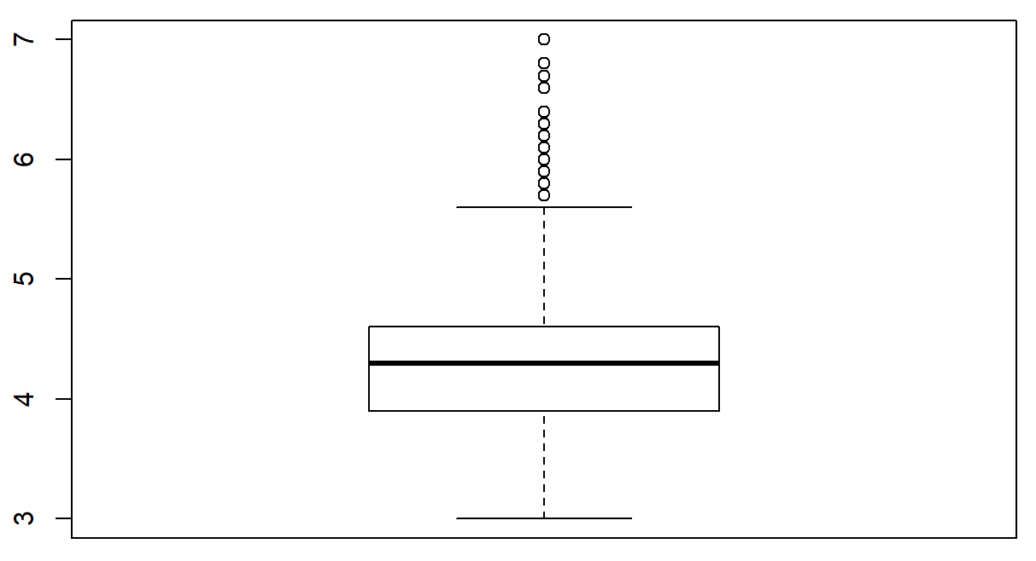
What we were able to determine is what appears to be a very Accurate Attrition Rate
A Few Observations of Our Model
Minimum Score was 3.0 and Maximum 7.0 with 85.6% of the scores between 3.5 and 5.0.
Summary Statistics
Mean Score: 4.353 Median Score: 4.300
1st Quartile (3.0 to 3.9): 4 of 378 Employees Left – 1.06%
2nd Quartile (4.0 to 4.3): 26 of 449 Employees Left – 5.79%
3rd Quartile (4.4 to 4.6): 43 of 281 Employees Left – 15.30%
4th Quartile (4.7 to 7.0): 164 of 362 Employees Left - 45.30%
Boxplot of Total Attrition Score
As the next two slides will show, the trends are very strong when considering the 27 variables
Although there is risk involved in the admitted flaws, we will use this as our first iteration of a prediction model
We can improve in the future as we gather more data and test our predictions against attrition

Slide 22
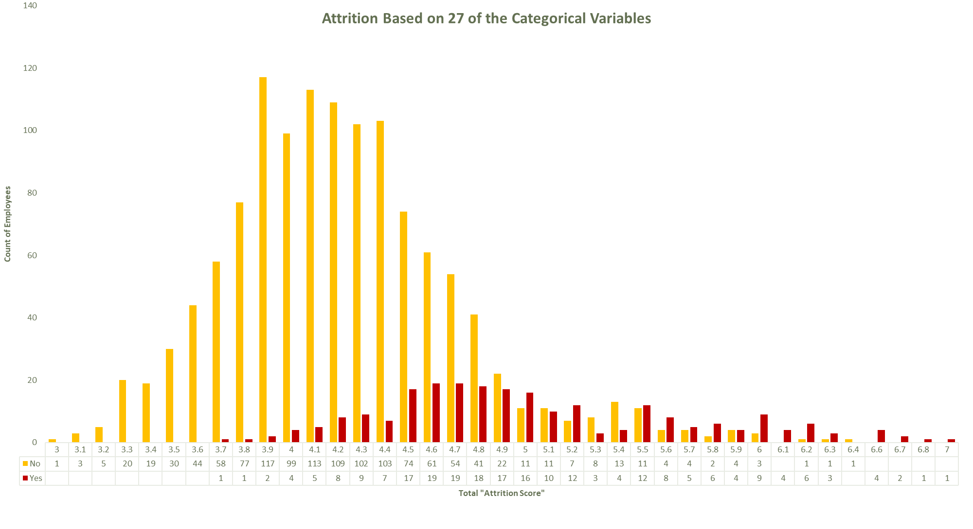

Slide 23
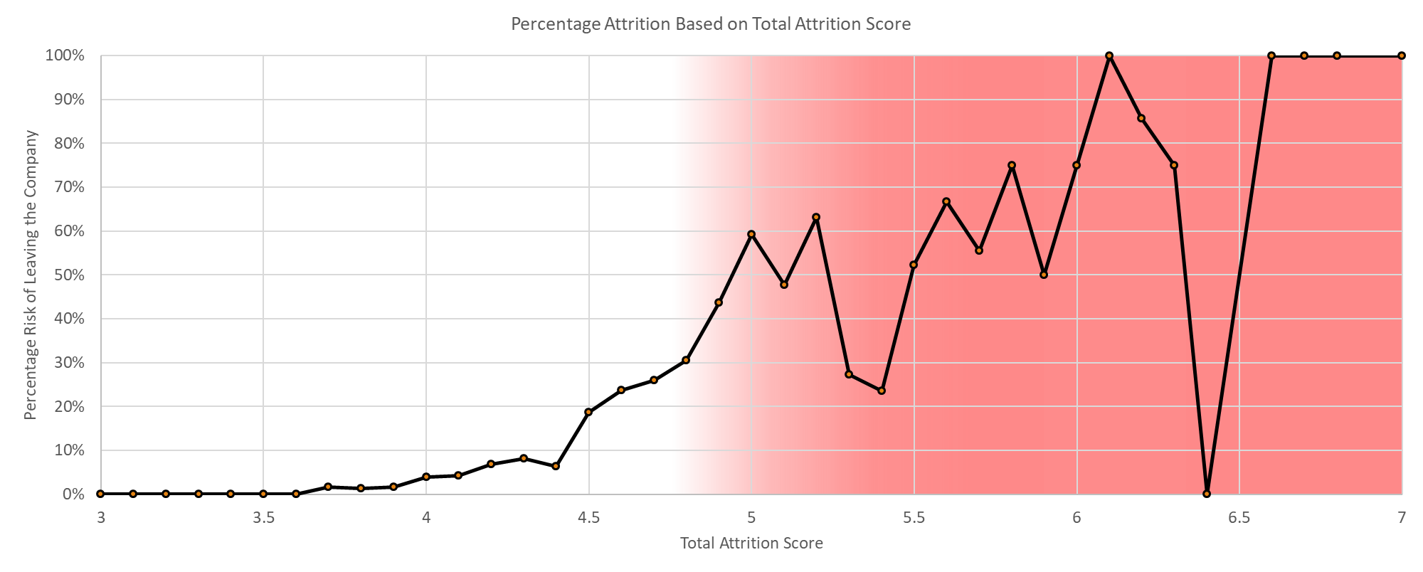
Percentage Attrition Based on the Attrition Score
For a Total Attrition Score of 5 or higher, we can expect 50% to 100% of those employees to leave the firm.

Slide 24
Conclusion and Suggestions
We must treat any employee with a Total Attrition Score over 5 as an extreme risk of leaving the company.
The most important factors that indicate employees to leave are Monthly Salary, Job Level and Total Years in the Workface.
Employees who work Overtime and those who are our Sales Representatives appear to be the two variables where the correlation to attrition is greatest.
We need to improve our Employee Survey. No trends are identifiable based upon the responses.
Important to remember it is impossible to completely qualify and quantify a person. There will be margin for error.
What is clear is our older and experienced workers are very happy and the retention rate is very high.
Of the our employees with over 11 years experience and 36 years old, we lost only 39 of 432 which includes retirements.
Bottom Line: We must improve the happiness for the younger portion where we can whether that be salary or additional benefits that allows us to retain them.
Observations of what we need to improve on.
For the health of our company and retention of our employees we must act upon these findings.

